Slide 1

Import Surcharge Project
(Adjustment System)
*NOTE: This is a working document and
WILL change as the project progresses.

Slide 2
Issue
Issue: Global container shipping rates are drastically increasing in response to approximately 30% of the global container shipping capacity being taken off-line.
Opportunity: Need to add an Import Surcharge to imported products to offset the additional costs. If nothing is done the impact of the increased container costs will continue to impact profits.
Objective: Create a solution that enables a surcharge to be applied to invoices with maximum visibility and flexibility to both new orders and open orders.​
Cost avoidance : $104M/year

Slide 3
Adjustment System
MVP
Surcharge to be managed at global level. Global setting can be overridden at Customer level.
  The surcharge “Import Surcharge” will be enabled by “Item Class”.
  Item Classes that the surcharge applies too will be added to a new surcharge table.
  Each Item Class will carry its own x% surcharge and effectivity dates.
  Surcharges to be set with effectivity dates based on order date.
Allow for customer exceptions: exclusions or a different %.
Invoice Calculation will be by line-item if Item Class applies with totals to follow.
  Example: Price (for 1) * % Surcharge
  The surcharge will be rounded up to the nearest $.
    If a quantity is passed, the surcharge amount will be extended.
  Surcharge will be recalculated on the fly until point of shipment/invoicing.
  Surcharge will be non-commissionable and non-taxable.
Machine to machine communication: roll surcharge into line-item price.
Human readable: line-item price and surcharge will be separate.

Slide 4
Adjustment System - Future
Surcharge to be managed at global level. Global setting can be overridden at Customer level.
  The surcharge (Name: “Import Surcharge”) will be enabled by “Item Class”.
    Future: adjustments can have other levels. Ex: Sales Class, Warehouse, Item, etc.
  Item Classes that the surcharge applies too will be added to a new surcharge table.
    Future: we will have the ability to have a primary level and secondary level to allow more flexibility
  Each Item Class will carry its own x% surcharge and effectivity dates.
    Future: will have the flexibility to have other types in the future. (Ex. flat rate, cube, weight, etc.
  Surcharges to be set with effectivity dates and as of order date.
    Future: want flexibility to also utilize invoice date in the future.
    Future: Also want the ability in the future to define a recalculate date for open orders.
Allow for customer exceptions: exclusions or a different %.
    Future: all the same flexibility as the standard
Invoice Calculation will be by line-item if Item Class applies with totals to follow.
  Example: Price (for 1) * % Surcharge
    Future: allow line-item level or order level surcharges.
  The surcharge will be rounded up to the nearest $.
    If a quantity is passed, the surcharge amount will be extended.
  Surcharge will be recalculated on the fly until point of shipment/invoicing.
  Surcharge will be non-commissionable and non-taxable.
    Future: allow option to pay commission and charge taxes. Also, refundable functionality.
Machine to machine communication: roll surcharge into line-item price.
    Future: can work with customers for joint development to separate.
Human readable: line-item price and surcharge will be separate.
Import Surcharge is only one use of this.
Future: because of the added flexibility, we want to call this an “Adjustment” rather than a “Surcharge”

Slide 5
Adjustment System
User Interface

Slide 6
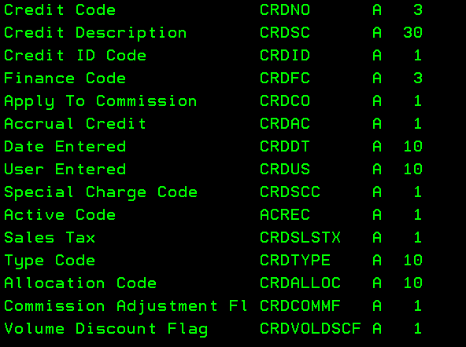
Global Adjustment Header
Creation Date
ID
Description
Primary Level
Secondary Level
Invoice Level
Commissionable
Taxable
Refundable
Charge
100
XXXX Surcharge
Item Class
none
Line Item
X
6/26/2024 8:30pm
Global Adjustment Header Table (AshleyNET)
Adjustment Header
adjustment_id | Unique identifier | I
adjustment_name | CRDNO || “ “ || CRDSC | A | 35
credit_code | CRDNO | A | 3
calculation_level | calc_id From control |  | Int
commissionable | CRDCO B=INVOICE & CM I=INVOICE ONLY N=NEITHER | A | 1
taxable | CRDSLSTX Y=yes N=no | A | 1
invoice_level | CRDOPNFL1F 1=line-item level 2=Order level | A | 1
refundable | CRDOPNFL2F Y=yes N=no | A | 1
charge | Boolean | B
active_code | Boolean | B
creation_date_time creation_user | Date/time stamp User id
last_change_date_time last_change_user | Date/time stamp User id
Credit Code Master Table
ACRDMAS
API
Notes:
Option 1079

Slide 7
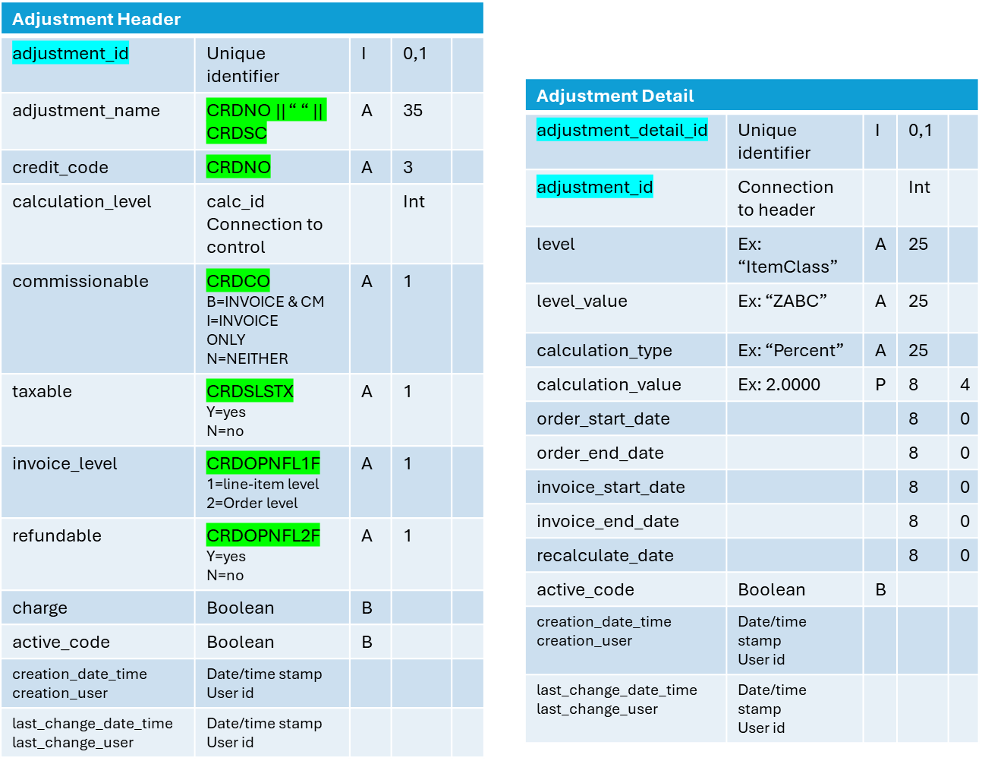
Global Adjustment Header
Creation Date
ID
Description
Primary Level
Secondary Level
Invoice Level
Commissionable
Taxable
Refundable
Charge
100
XXXX Surcharge
Item Class
none
Line Item
X
6/26/2024 8:30pm
Global Adjustment Detail
Calculation
Level
Calculation Type
Order Date
From
Order Date
To
Invoice Date
From
Invoice Date
To
Recalculate Date
ID
Adjustment
Value
Value
100
100 XXXX Surcharge
Item Class
CLASS_A
Per Cent
5.00
06/01/2024
12/31/2024
07/01/2024
12/31/2024
07/01/2024
101
100 XXXX Surcharge
Item Class
CLASS_B
Per Cent
4.00
06/01/2024
12/31/2024
07/01/2024
12/31/2024
07/01/2024
102
100 XXXX Surcharge
Item Class
CLASS_C
Per Cent
4.50
06/01/2024
12/31/2024
07/01/2024
12/31/2024
07/01/2024
103
100 XXXX Surcharge
Item
ITEM_A
Per Cent
4.00
06/01/2024
12/31/2024
07/01/2024
12/31/2024
07/01/2024
Notes:
Business would like to load all item classes with same date range (given at entry) then allow to adjust the exceptions.
Question about defaulting the %. Renae will consider what can be done here.

Slide 8
Global Adjustment Header
Creation Date
ID
Description
Primary Level
Secondary Level
Invoice Level
Commissionable
Taxable
Refundable
Charge
100
XXXX Surcharge
Item Class
none
Line Item
X
6/26/2024 8:30pm
Global Adjustment Detail
Calculation
Level
Calculation Type
Order Date
From
Order Date
To
Invoice Date
From
Invoice Date
To
Recalculate Date
ID
Adjustment
Value
Value
100
100 XXXX Surcharge
Item Class
CLASS_A
Per Cent
5.00
06/01/2024
12/31/2024
07/01/2024
12/31/2024
07/01/2024
101
100 XXXX Surcharge
Item Class
CLASS_B
Per Cent
4.00
06/01/2024
12/31/2024
07/01/2024
12/31/2024
07/01/2024
102
100 XXXX Surcharge
Item Class
CLASS_C
Per Cent
4.50
06/01/2024
12/31/2024
07/01/2024
12/31/2024
07/01/2024
103
100 XXXX Surcharge
Item
ITEM_A
Per Cent
4.00
06/01/2024
12/31/2024
07/01/2024
12/31/2024
07/01/2024
Adjustment Detail Customer Override
Customer: CUSTOMER_A Ship To: 01
Calculation
Level
Calculation Type
Order Date
From
Order Date
To
Invoice Date
From
Invoice Date
To
Recalculate Date
ID
Adjustment
Value
Value
100
100 XXXX Surcharge
Item Class
CLASS_A
Per Cent
4.00
06/01/2024
12/31/2024
07/01/2024
12/31/2024
07/01/2024
101
100 XXXX Surcharge
Item Class
CLASS_B
Per Cent
3.00
06/01/2024
12/31/2024
07/01/2024
12/31/2024
07/01/2024
102
100 XXXX Surcharge
Item Class
CLASS_C
Per Cent
3.50
06/01/2024
12/31/2024
07/01/2024
12/31/2024
07/01/2024
103
100 XXXX Surcharge
Item
ITEM_A
Per Cent
3.00
06/01/2024
12/31/2024
07/01/2024
12/31/2024
07/01/2024

Slide 9
Global Adjustment Maintenance Rules
These rules will be applied to the Global Adjustment Maintenance UI.
Adjustment Header
  To create a new adjustment, the user will enter a credit code. The UI will call the ACRDMST API to retrieve the credit code information.
  Adjustment ID will be a system generated number.
  Fields populated by the API cannot be maintained in AshleyNET.
    Fields: Adjustment Name = CRDNO, space, CRDSC; credit_code = CRDNO; commissionable = CRDCO; taxable = CRDSLSTX; Invoice Level = CRDOPNFL1F; refundable = CRDOPNFL2F
    The user should be able to repopulate from the API ONLY if no adjustment detail record is active. (all “from” dates are in the future)
    If changes are necessary after a surcharge is active, the surcharge ID detail must be set to end on a near future date (respecting time fence) and a new surcharge created with the changes.
  There should be a control table containing all valid combinations for primary and secondary Calculation Levels.
    It should only be maintainable by IT.
    For MVP, only two entries will be present. Development in the microservice will be necessary before adding any future options.
      MVP Fields:
        Calculation ID = 1; Level = 1; Value = “ITEMCLASS”; (for primary)
        Calculation ID = 1; Level = 2; Value = “NONE” (for secondary)
  There should be a control table containing all valid Invoice Levels.
    It should only be maintainable by IT.
    MVP: 1=line-item level, 2=Order level
  Charge should default to checked but can be unchecked by the user if no detail record is active.
  Active Code: all records will be active upon creation. They can be set to inactive by the user only if neither from date in the detail have passed. Once a from date has passed, the user can only maintain the to dates. Once the to dates have passed, then the record can be set to inactive if desired.
  At record creation, the creation date/time/user should be updated and the last change date/time/user.
  Upon update, the last change date/time/user should be updated

Slide 10
Global Adjustment Maintenance Rules
These rules will be applied to the Global Adjustment Maintenance UI.
Adjustment Detail
  Pulling in item classes should be automated.
    Only “end item” item classes should be pulled in. (AS400 Table: AENDCLS)
      Is the data replicated to SQL? Do we need an API?
    User should be able to enter a default setting for calculation type, value, order from date, and order to date as the item classes are pulled in. User can modify after the fact.
    User should be able to set the default based on Import/Domestic, Product Line Code, Sales Category, Division Code, Retail Category, or Financial Division. (All defined in AENDCLS)
  There should be a control table containing all valid Calculation Types and the min/max values acceptable.
    It should only be maintainable by IT.
    For MVP, only one entry will be present. Development in the microservice will be necessary before adding any future options.
      MVP: Calculation Type = “Percentage”; Minimum Value = 0; Maximum Value = ?;
    The UI will provide edit checks to support the min/max values.
  Calculation type can be maintained until the earliest “From” date has passed. Then the field should no longer be maintainable.
  Value can be maintained until the earliest “From” date has passed. Then the field should no longer be maintainable.
  There should be a control table containing the Time Fence in days.
    It should only be maintainable by IT. (start with 7 days in all 3 time fences)
    It should have a “From” time fence, a “To” time fence, and a “Recalculate” time fence
  Order From Date must be outside the “From” time fence. (It must be x days greater than the current date)
    The Order From Date is not maintainable once it is inside the “From” time fence. (Less than x days greater than the current date)
  Order To Date must be greater than the Order From Date and greater than the “To” time fence.
    This date is not maintainable once it is inside the “To” time fence. (It must be x days greater than the current date)
    If maintained, it must remain greater than the from date and outside the “To” time fence.
  Invoice From/To Date are not functional in MVP.
    They should be allowed to remain unset.
    If set, Invoice From/To should follow the same rules as order From/To date respecting time fences.
  Recalculate Date is not functional in MVP.
    If set, Recalculate Date must be outside the “Recalculate” time fence and greater than or equal to both the Order From Date and Invoice From Date if set.
  At record creation, the creation date/time/user should be updated and the last change date/time/user.
  Upon update, the last change date/time/user should be updated.
  Active Code: all records will be active upon creation. They can be set to inactive by the user only if neither from date has passed. Once a from date has passed, the user can only maintain the to dates. Once the to dates have passed, then the record can be set to inactive if desired.

Slide 11
Global Adjustment Maintenance Rules
These rules will be applied to the Global Adjustment Maintenance UI.
Adjustment Detail – Customer Override
  User should be able to set up a customer override for an adjustment
  The override will be for a customer/”ship to” combination.
    “ship to” will be blank for a “bill to”
  There will be two options for overriding
    The user can choose to “exclude” a customer/”ship to” from an adjustment
      This excludes the customer/”ship to” from the entire adjustment (all detail records)
    The user can choose to customize the detail settings for a customer/”ship to”
      This option will pull the detail settings for the given surcharge into the override table for the customer/”ship to” and allow the user to maintain the Calculation value and dates.
      ALL rules for the dates on the detail UI will also be enforced on the override UI.
  At record creation, the creation date/time/user should be updated and the last change date/time/user.
  Upon update, the last change date/time/user should be updated
  Active Code: all records will be active upon creation. They can be set to inactive by the user only if neither from date has passed. Once a from date has passed, the user can only maintain the to dates. Once the to dates have passed, then the record can be set to inactive if desired.

Slide 12
Adjustment Tables
Adjustment Customer Override
override_id | Unique identifier | I | 0,1
adjustment_id | Connection to header |  | Int
adjustment_detail_id | Connection to detail |  | Int
customer_id |  | P | 8 | 0
customer_ship_to |  | A | 4
override_type | E=Exclude C=Custom | A | 1
calculation_type | Ex: “PERCENT” | A | 25
calculation_value | Ex: 2.0000 | P | 8 | 4
order_start_date |  |  | 8 | 0
order_end_date |  |  | 8 | 0
invoice_start_date |  |  | 8 | 0
invoice_end_date |  |  | 8 | 0
recalculate_date |  |  | 8 | 0
active_code | Boolean | B
creation_date_time creation_user | Date/time stamp User id
last_change_date_time last_change_user | Date/time stamp User id
Adjustment Header
adjustment_id | Unique identifier | I | 0,1
adjustment_name | CRDNO || “ “ || CRDSC | A | 35
credit_code | CRDNO | A | 3
calculation_level | calc_id Connection to control |  | Int
commissionable | CRDCO B=INVOICE & CM I=INVOICE ONLY N=NEITHER | A | 1
taxable | CRDSLSTX Y=yes N=no | A | 1
invoice_level | CRDOPNFL1F 1=line-item level 2=Order level | A | 1
refundable | CRDOPNFL2F Y=yes N=no | A | 1
charge | Boolean | B
active_code | Boolean | B
creation_date_time creation_user | Date/time stamp User id
last_change_date_time last_change_user | Date/time stamp User id
Adjustment Detail
adjustment_detail_id | Unique identifier | I | 0,1
adjustment_id | Connection to header |  | Int
level | Ex: “ITEMCLASS” | A | 25
level_value | Ex: “ZABC” | A | 25
calculation_type | Ex: “PERCENT” | A | 25
calculation_value | Ex: 2.0000 | P | 8 | 4
order_start_date |  |  | 8 | 0
order_end_date |  |  | 8 | 0
invoice_start_date |  |  | 8 | 0
invoice_end_date |  |  | 8 | 0
recalculate_date |  |  | 8 | 0
active_code | Boolean | B
creation_date_time creation_user | Date/time stamp User id
last_change_date_time last_change_user | Date/time stamp User id

Slide 13
Time Fence Functionality
Adjustment Creation & Maintenance
“From” Time Fence
Today
First Available “From” Date
Surcharge
From: 1/1/2025
To: 12/31/2025
Time fence: x days
“To” Time Fence
First Available “To” Date
“Recalculate” Time Fence
First Available “Recalculate” Date
Order From Date must be outside the “From” time fence. (It must be x days greater than the current date)
  The Order From Date is not maintainable once it is inside the “From” time fence. (Less than x days greater than the current date)
  The Order From Date is also not maintainable once the date is in the past.
Order To Date must be greater than the Order From Date and greater than the “To” time fence.
  This date is not maintainable once it is inside the “To” time fence. (It must be x days greater than the current date)
  If maintained, it must remain greater than the from date and outside the “To” time fence.
Invoice From/To Date are not functional in MVP.
  They should be allowed to remain unset.
  If set, Invoice From/To should follow the same rules as order From/To date respecting time fences.
Recalculate Date is not functional in MVP.
  If set, Recalculate Date must be outside the “Recalculate” time fence and greater than or equal to both the Order From Date and Invoice From Date if set.

Slide 14
Adjustment System
Microservice

Slide 15
Microservice Definition
Microservices, or microservices architecture, is a software development style that separates a large application into smaller, independent services.
Each service is responsible for a single feature and has its own technology stack, including a database and data management model.
The services communicate with each other using well-defined APIs, such as representational state transfer (REST), event streaming, and message brokers.

Slide 16
Adjustment Microservice MVP
DB2
All Processes Needing Adjustment Info
Pre-Invoicing
ACRDMAS
API
3
Data Sync Trigger
1
Documentation
Existing Windows VM
API Server(s)
AshleyNET
Adjustment
Maintenance
UI
2
Data Sync APIs
1
Adjustment Master Data APIs
2
Calculation APIs
3
Documentation
Private Data
SQL Server
SQL Server
PIM
All Processes Needing Adjustment Info
Pre-Invoicing
Product Data
Product Data API
2
3
Notes:
ACRDMAS maintained by option 1079.
“Switch” needs to be a procedure
Calculation microservice needs to cache order information for rolling 24 hours.

Slide 17

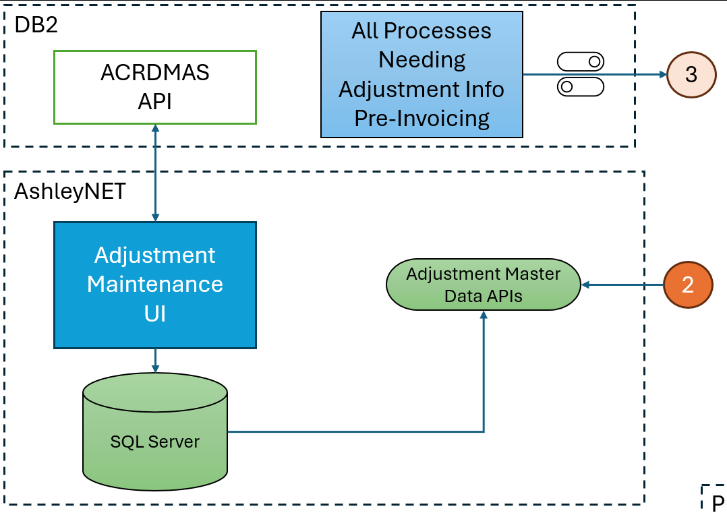
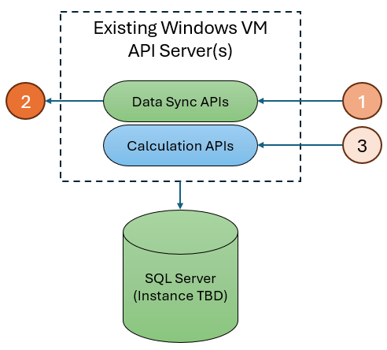
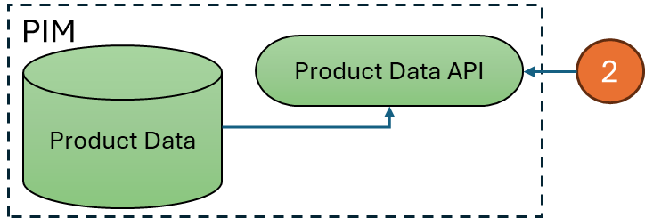
Microservice Future Possibilities
Equinix
Azure Kubernetes Pod
(MVP)
Azure App Service
TBD

Slide 18
Microservice Logic
Receive Parms
Check Switch
Status?
OFF
Return level 0
Private Data
Local to Microservice
Private Product Data
Retrieve product data for all Items
Process Calculator for each order/item
Private Header Data
Determine if any Item Class Adjustments
<LOGIC>
Private Detail Data
Future Adjustment
Private Override Data
Future Adjustment
Return Adjustments

Slide 19
Data Contract Hierarchy
INBOUND
OUTBOUND
See documentation for most current JSON layout.
LINK
{
"orders": [
{
ORDER DETAIL
"items": [
{
ITEM DETAIL
},
{
ITEM DETAIL
}
]
},
{
ORDER DETAIL
"items": [
{
ITEM DETAIL
},
{
ITEM DETAIL
}
]
}
],
}
{
"orders": [
{
ORDER DETAIL
“adjustments": [
{
ITEM DETAIL
“adjustment_details": [
{
ADJUSTMENT DETAIL
}
{
ADJUSTMENT DETAIL
}
{
ITEM DETAIL
“adjustment_details": [
{
ADJUSTMENT DETAIL
}
{
ORDER DETAIL
“adjustments": [
{
ITEM DETAIL
“adjustment_details": [
{
ADJUSTMENT DETAIL
}
{
ITEM DETAIL
“adjustment_details": [
{
ADJUSTMENT DETAIL
}
]
}
]
}
]
}

Slide 20
Inbound JSON Data Contract
Allows for multiple orders
See documentation for most current JSON layout.
LINK
Example:
{
"orders": [
{
"order_id": “string", - Optional
"customer_id": number,
"ship_to": “string", (blank for a bill to)
"order_date": “string(ISO 8601 format)",
"est_ship_date": “string(ISO 8601 format)", - Optional
"invoice_date": “string(ISO 8601 format)", - Optional
"warehouse_id": “string", - Optional
"items": [
{
"item_id": “string",
"quantity": number, - Optional
"price": number
},
{
"item_id": “string",
"quantity": number, - Optional (returns for a qty of 1 unless provided)
"price": number
}
]
},
{
"order_id": “string", - Optional
"customer_id": “string",
"ship_to": “string", (blank for a bill to)
"order_date": “string(ISO 8601 format)",
"est_ship_date": “string(ISO 8601 format)", - Optional
"invoice_date": “string(ISO 8601 format)", - Optional
"warehouse_id": “string", - Optional
"items": [
{
"item_id": “string",
"quantity": number, - Optional (returns for a qty of 1 unless provided)
"price": “number”
}
]
}
],
}
{
"orders": [
{
"order_id": "ORD-001",
"customer_id": 8888300,
"ship_to": "480",
"order_date": "2024-06-27T10:30:00Z",
"est_ship_date": "2024-06-30T14:00:00Z",
"invoice_date": "2024-06-28T09:00:00Z",
"warehouse_id": "WH-005",
"items": [
{
"item_id": "ITEM-A",
"quantity": 2,
"price": 29.99
},
{
"item_id": "ITEM-B",
"quantity": 1,
"price": 49.99
}
]
},
{
"order_id": "ORD-002",
"customer_id": "8888300",
"ship_to": "480",
"order_date": "2024-06-27T11:45:00Z",
"est_ship_date": "2024-07-01T10:00:00Z",
"invoice_date": "2024-06-28T15:30:00Z",
"warehouse_id": "WH-003",
"items": [
{
"item_id": "ITEM-C",
"quantity": 3,
"price": 19.99
}
]
}
],
}
*Green = Optional

Slide 21
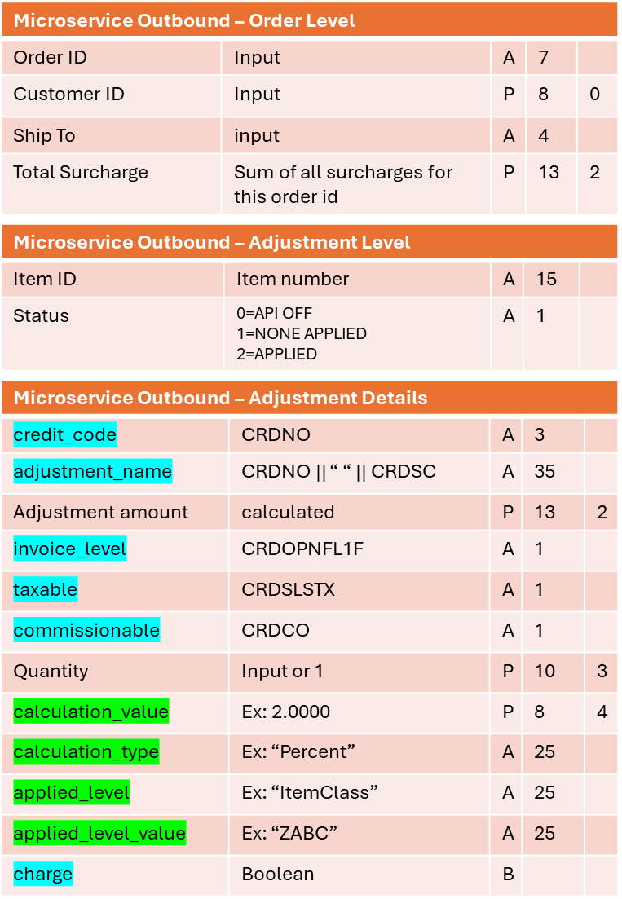
Outbound JSON Data Contract
Example:
{
"orders": [
{
"order_id": "ORD-001",
"customer_id": 8888300,
"ship_to": "480",
"total_surcharge": 13.49,
“adjustments": [
{
"item_id": "ITEM-A",
“status”: “2”,
“adjustment_details": [
{
“credit_code”: “HDF”
“adjustment_name": “HDF Handling Fee",
“adjustment_amount": 5,
“invoice_level": "1",
"taxable": “N”,
"commissionable": “N”,
"quantity": 2,
“calculation_value": 8.33,
“calculation_type": “Percent”,
"applied_level": "ITEM CLASS",
“applied_level_value": "CLASS-A“,
“charge”: true
}
]
},
{
"item_id": "ITEM-B",
“status”: 2,
“adjustment_details": [
{
“credit_code”: “OIF”
“adjustment_name": “OIF Oversize Item Fee",
“adjustment_amount": 8.49,
“invoice_level": “2",
"taxable": “N”,
"commissionable": “N”,
"quantity": 1,
“calculation_value": 17,
“calculation_type": “Percent”,
"applied_level": "ITEM CLASS",
“applied_level_value": "CLASS-B“,
“charge”: true
}
]
}
]
},
]
}
Allows for multiple orders, multiple items, multiple adjustments per item.
See documentation for most current JSON layout.
LINK
{
"orders": [
{
"order_id": "string",
"customer_id": number,
"ship_to": "string",
"total_surcharge": number,
“adjustments": [
{
"item_id": "string",
“status”:”string” 0=API OFF, 1=NONE APPLIED, 2=APPLIED,
“adjustment_details": [
{
“credit_code”: “string”,
“adjustment_name": "string",
“adjustment_amount": number,
“invoice_level": "string",
"taxable": “string",
"commissionable": “string”,
"quantity": number,
“calculation_value": number,
“calculation_type": “string",
"applied_level": "string",
“applied_level_value": "string”,
“charge”: Boolean
}
]
}
]
}
]
}
*Green = Optional

Slide 22
Outbound Stub Result
Microservice Outbound – Order Level
Order ID | Input value | A | 7
Customer ID | Input value | P | 8 | 0
Ship To | Input value | A | 4
Total Surcharge | Stub: 5 | P | 13 | 2
LWise@Ashleyfurni... - Ashley Fur...
If the switch is on, this is the return
If the switch is off, this is the return
{
"orders": [
{
"order_id": whatever is passed in,
"customer_id": whatever is passed in,
"ship_to": whatever is passed in,
"total_surcharge": 5,
“adjustments": [
{
"item_id": whatever is passed in,
“status”: “2”,
“adjustment_details": [
{
“credit_code”: “IMP”
“adjustment_name": “IMP IMPORT SURCHARGE",
“adjustment_amount": 1,
“invoice_level": “1",
"taxable": “N",
"commissionable": “N”,
"quantity": whatever is passed in or 1,
“calculation_value": 1,
“calculation_type": “PERCENT",
"applied_level": “ITEMCLASS",
“applied_level_value": “CLASS_A”,
“charge”: true
}
]
}
]
}
]
}
See documentation for most current JSON layout.
LINK
{
"orders": [
{
"order_id": whatever is passed in,
"customer_id": whatever is passed in,
"ship_to": whatever is passed in,
"total_surcharge": 0,
“adjustments": [
{
"item_id": whatever is passed in,
“status”: “0”,
“adjustment_details": [ ]
}
]
}
]
}
Microservice Outbound – Adjustment Level
Item ID | Input value | A | 15
Status | Stub: “2” | A | 1
Microservice Outbound – Adjustment Details
credit_code | Stub: “IMP” | A | 3
adjustment_name | Stub: “IMP IMPORT SURCHARGE” | A | 35
Adjustment amount | Stub: 1 | P | 13 | 2
invoice_level | Stub: “1” | A | 1
taxable | Stub: “N” | A | 1
commissionable | Stub: “N” | A | 1
Quantity | Stub: Input value or 1 | P | 10 | 3
calculation_value | Stub: 1 | P | 8 | 4
calculation_type | Stub: “PERCENT” | A | 25
applied_level | Stub: “ITEMCLASS” | A | 25
applied_level_value | Stub: “CLASS_A” | A | 25
charge | Stub: true | B
*Green = Optional

Slide 23
Adjustment Microservice SOP
Inbound
Outbound
See documentation for most current JSON layout.
LINK
Order Level (one per order)
  Order ID: optional
    MVP: not used
    Future: could be used to gather order level detail
  Customer: required
  Ship To: required. Blank for bill to level.
  Order Date: required. Impacts the adjustment decision.
  Estimated ship to: Optional
    MVP: not used
    Future: possible implications
  Invoice Date: Optional
    MVP: not used
    Future: possible implications
  Warehouse ID: Optional
    MVP: not used
    Future: possible implications
Item Level (one per item on this order)
  Item ID: required
  Quantity: optional
    Quantity of 1 will be assumed if not provided
  Price: Required
    MVP: used to calculate adjustment
    Should be the total price for the quantity given
      No unit of measure necessary.
Order Level (one per order submitted)
  Order ID: optional. Same as Inbound
  Customer ID: Same as Inbound
  Ship To: Same as Inbound
  Total Surcharge: Summary total surcharge amounts for this order
Adjustments Level (one per item submitted this order)
  Item ID: Same as Inbound
  Status: (Alpha 1) 0=API OFF, 1=NONE APPLIED, 2=APPLIED
    If 0 or 1, no adjustment details will be sent for this item
Adjustment Details (can be multiple per item)
  Credit Code: Credit Code associated with the adjustment
  Adjustment Name: Name of adjustment being applied
  Adjustment Amount: dollar amount of this adjustment for quantity given
  Invoice level: (Alpha 1) 1=line-item level, 2=Order level
  Taxable: (Alpha 1) B=INV& CM; I=INV ONLY; N=NEITHER
  Commissionable: (Alpha 1) Y=yes; N=no
  Quantity: Same as Inbound if given or 1
  Calculation value: number value used in calculation
  Calculation type: type of calculation performed
  Applied level: attribute used to qualify for adjustment
  Applied Level value: attribute value
  Charge: (Boolean) true or false
    True = this is a charge that will increase the invoice amount
    False = this is a credit that will decrease the invoice amount

Slide 24
Adjustment Calculation
Inbound
Calculation
  Item ID: ITEMABC
  Quantity: 10
  Price: $442.50
  Calculate the each $ amount
    $442.50 / 10 = $44.25 each
    Note: if no quantity passed the assume 1.
  Calculate the each $ surcharge
    $44.25 * 6% = $2.66 surcharge
  Round up to next dollar
    $3.00 surcharge each
  Multiply rounded surcharge by the quantity to get Adjustment Amount to return.
    $3.00 * 10 = $30 total surcharge
  Return the total surcharge to the caller
    Adjustment Amount = $30
Surcharge Example
  Calculation Type: PERCENT
  Calculation Value: 6%

Slide 25
Adjustment Microservice Scenarios
Item Level Calculated
Item Level Displayed
Item Level Calculated
Order Level Displayed
Order Level Calculated
Order Level Displayed
Invoice level: 1=line-item level
Adjustment calculated item by item
JSON Outbound: Item by item
Print/Display: item by item
  Most will also summarize at the bottom
Invoice level: 2=Order level
Adjustment calculated item by item
JSON Outbound: Item by item
Print/Display: total at bottom of invoice
NOTE: Outside the scope of the MVP
Adjustment calculated for the order
JSON Outbound: on order level (json example below)
Print/Display: total at bottom of invoice

Slide 26
Private Data Sync Logic
Data Sync Initiation =
Daily Scheduled Job
PIM
API List
w/destination table & Last Call Date
PIM
Product Data
Retrieve
Entries & update with current date/time
Private Data
Local to Microservice
PIM API
Gather changed Data
Call APIs with Last Call Date
Private Product Data
PIM API
Gather changed Data & Update Private Data
Header API
Gather changed Data & Update Private Data
Private Header Data
Detail API
Gather changed Data & Update Private Data
Private Detail Data
Private Override Data
Override API
Gather changed Data & Update Private Data
AshleyNET
UI Header Data
UI Detail Data
UI Override Data

Slide 27
Microservice Data Sync Process Initiation
There will be a daily scheduled job to call the Microservice Data Sync APIs.
  There will be one parameter: last call date/time
The APIs calls should be in a control table to allow additions for every new instance of the Microservice.
A control table will hold the following information:
  API URL
    One for each API to be called. MVP: there will be 4
  Last Call date of this API
    The current contents of the record will be passed as the parm.
    The date will be updated to the current date/time after pulled for the parm but before the actual call to insure there is no gap in updates.
  Destination table location
    (future: the same API can be called to sync multiple destinations.)

Slide 28
Microservice Private Data Sync APIs
The microservice data sync APIs will be located along side the microservice API.
There will be 3 Adjustment APIs: Header, Detail, Override
  Each API will receive the last run parm.
  Each API will call its respective counterpart in AshleyNET passing the last run parm.
    The return data set will be all changed records for the respective table since the last run date/time.
    The API will then sync (update/add) the data set returned with the respective private data table.
      Note that calls to the microservice will be ongoing so there can be no outage of data.
    Finally, the API should remove all records flagged as inactive.
There will be a Product Data Sync API to sync Product Data into the private data
  The API will receive the last run parm.
  The API will call the PIM Product Data API in the PIM system with the last run date to retrieve changes since the last run date.
    Include Item List = True
    Multiple Environment Item List = True
  The API will update the private data with changes.

Slide 29
Adjustment Maintenance Data APIs
The Adjustment Maintenance Data APIs will be located in AshleyNET.
There will be three APIs: Header, Detail, Override
  Each API will receive the last run parm.
  Each API will review the data for that table and return the records which have a last update date/time greater than or equal to the last run date/time parm.

Slide 30
PIM Product Data API
This API already exists in the PIM system.
Here is the link to the Product Data API schema. (from Igor Karam)
http://plmapi.ashleyfurniture.com/Ashley.ProductData.Maintenance.Service/Services/ProductDataMaintenanceService.svc/productdownload/help/operations/LoadProductDownloadByListOfItemNumbers
It can be called in multiple ways:
  with a list of items.
  with a last changed date. (method to be called by the daily sync process)
  Etc.
To retrieve the data we need, it should be called with:
    Include Item List = True
    Multiple Environment Item List = True
Take the data returned an update the Microservice Private Data table
NOTE: we will need to do a one-time initial load of items to the private data. Suggested to load all items that appear in a price list.

Slide 31
Product Data API
Below is the VB code to do a test call by changed date. Let me know if you have any questions. (from Joe Waldrop)
Imports System.Globalization
Imports System.ServiceModel
Imports ProductDataServiceTestVB.ServiceProxy
Imports Ashley.Engineering.CommonObjects
Public Class Form2
Private Sub Form2_Load(sender As Object, e As EventArgs) Handles Me.Load
Dim Request As ProductDataServiceTestVB.ServiceProxy.LoadProductDownloadChangesAfterSpecifiedDateTimeRequest
Dim Response As ProductDataServiceTestVB.ServiceProxy.LoadProductDownloadChangesAfterSpecifiedDateTimeResponse
Dim ServiceClient As New ServiceProxy.ProductDownloadServiceClient
Dim Items() As Item
Dim MultiEnvironmentItems() As MultiEnvironmentItem
Dim basicHttpBinding As BasicHttpBinding = New BasicHttpBinding()
Try
'setup
basicHttpBinding.MaxReceivedMessageSize = 6553600
ServiceClient.Endpoint.Binding = basicHttpBinding
Request = New ServiceProxy.LoadProductDownloadChangesAfterSpecifiedDateTimeRequest()
'Set the request properties
Request.ClientCulture = CultureInfo.CurrentCulture.Name
Request.UserName = Environment.UserName
Request.MachineName = Environment.MachineName
Request.StartDateTime = "8/4/2024 11:46:00 PM"
Request.RequestOptions = New ProductDownloadRequestOptions With {
.IncludeItemList = True,
.IncludeMultiEnvironmentItemList = True
}
'call service
Response = ServiceClient.LoadProductDownloadChangesAfterSpecifiedDateTime(Request)
Items = Response.ItemList
MultiEnvironmentItems = Response.MultiEnvironmentItemList
Catch ex As Exception
'Error handling
Throw
Finally
'Change cursor
Cursor.Current = Cursor
End Try
End Sub

Slide 32
Invoicing /
Shipped History

Slide 33
Invoicing
DB2
Existing Windows VM
API Server(s)
Invoicing
3
4
Calculation APIs
3
Populate Shipped History & New Adjustment Table
Invoice
IWS API
SQL Server
(Instance TBD)
Shipped History
TSSCIN Special Charges
(NEW)
Adjustment Line-Item Detail
All Processes Needing Adjustment Info
POST-Invoicing
4

Slide 34
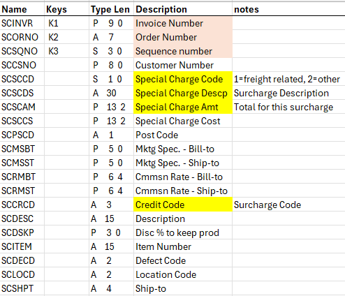
Shipped History
Shipped History
Special Charge Info File
(summary: bottom of invoice)
Special Charge Line-Item Detail
File: TSSCXN Lib: ASHLEY
Name | Keys | Type Len | Description | notes
SCINVR | K1 | P 9 0 | Invoice Number | links to special charge
SCORNO | K2 | A 7 | Order Number | links to special charge
SCSQNO | K3 | S 3 0 | Special Charge sequence number | links to special charge
SCCRCD |  | A 3 | Credit Code | Surcharge Code
ITITNO | K4 | A 15 | Item Number | Links to order line item
ITITSQ | K5 | P 7 0 | Item Sequence No | Links to order line item
 |  | A 30 | Adjustment Description | global header
 |  | P 13 2 | Adjustment Amount | calculated amount for this item
 |  | A 1 | invoice level | level of invoice to be applied
 |  | A 25 | calculation type | percent, flat rate, etc
 |  | P 8, 4 | calculation value | value of type to be applied
 |  | A 25 | adjustment level | ex: Item Class
 |  | A 25 | adjustment level value | ex: ZABC
< Detail
Invoice Level: 1=line-item level, 2=Order level

Slide 35
Business approved invoice format including surcharge
LINK

Slide 36
Assignments

Slide 37
Finance Teams Assignments
IT FIN Pricing Team
IT FIN Accounting Team
AS400 API over ACRDMAS
  To retrieve the credit code to drive the adjustment global master data.
  See Global Adjustment Header slide
Microservice
  Stub out where it can be called and return the same answer every time - Damo
  Create new servers - created
  Create a switch table where the switch value will be stored
  Implement the switch in the stub out to allow PROD deploy
  Create microservice tables in close proximity to the microservice
    Header, Detail, Customer Override, Product Data
Near data sync to microservice
  product data
Microservice
  Write surcharge logic for MVP
    Will respect the active switch
Adjustment System UI (AshleyNET)
  Create Control Tables
    Control Table: Calculation Levels (Item Class, etc)
    Control Table: Invoice Levels
    Control Table: Time Fence
    Control Table: Calculation Types (Percentage, etc)
  Create UI tables in AshleyNET
    Header, Detail, Customer Override
  Create UI(s)
    Header, Detail, Customer Override
Near real time data sync to microservice
  header, detail, override
Create control switch: ability to turn on/off the call to the microservice for ALL AS400 Applications. New table. – MJ/Bindhu
Create a procedure to be called to determine if the microservice call should be made or not (on/off) – MJ/Bindhu
Create new TSSCIN extension table to hold surcharge detail information. File: TSSCXN Special Charge Line-Item Detail – SK/Bindhu
Change option 1079 ACRDMAS maintenance to allow update of two user defined fields. Invoice Level = CRDOPNFL1F; refundable = CRDOPNFL2F – MJ/Bindhu
Change Invoicing process CS254D to call microservice to pull any surcharges. Store surcharge detail information in new table and summary in TSSCIN. – SK/MJ
Replicated new table TSSCXN to AshleyDirect (work with Bob Horton) – MJ
Change AshleyDirect to show invoice line-item adjustments
Change all finance programs that display invoice detail to show the line-item surcharge separate from the price on a line-item level. (these do not call the microservice) Including: - MJ/SK
  TSSCIN programs (35)
  Cost accounting cube
  Item count report
  credits

Slide 38

Data Path
LWise@Ashleyfurni... - Ashley Fur...
Adjustment UI
Adjustment Header
adjustment_id | Unique identifier | I | 0,1
adjustment_name | CRDNO || “ “ || CRDSC | A | 35
credit_code | CRDNO | A | 3
calculation_level | calc_id From control
commissionable | CRDCO B=INVOICE & CM I=INVOICE ONLY N=NEITHER | A | 1
taxable | CRDSLSTX Y=yes N=no | A | 1
invoice_level | CRDOPNFL1F 1=line-item level 2=Order level | A | 1
refundable | CRDOPNFL2F Y=yes N=no | A | 1
charge | Boolean | B
active_code | Boolean | B
creation_date_time creation_user | Date/time stamp User id
last_change_date_time last_change_user | Date/time stamp User id
Adjustment Customer Override
override_id | Unique identifier | I | 0,1
adjustment_id | Connection to header |  | Int
adjustment_detail_id | Connection to detail |  | Int
customer_id |  | P | 8 | 0
customer_ship_to |  | A | 4
override_type | E=Exclude C=Custom | A | 1
calculation_type | Ex: “Percent” | A | 25
calculation_value | Ex: 2.0000 | P | 8 | 4
order_start_date |  |  | 8 | 0
order_end_date |  |  | 8 | 0
invoice_start_date |  |  | 8 | 0
invoice_end_date |  |  | 8 | 0
recalculate_date |  |  | 8 | 0
active_code | Boolean | B
creation_date_time creation_user | Date/time stamp User id
last_change_date_time last_change_user | Date/time stamp User id
API
ACRDMAS
Adjustment Detail
adjustment_detail_id | Unique identifier | I | 0,1
adjustment_id | Connection to header |  | Int
level | Ex: “ItemClass” | A | 25
level_value | Ex: “ZABC” | A | 25
calculation_type | Ex: “Percent” | A | 25
calculation_value | Ex: 2.0000 | P | 8 | 4
order_start_date |  |  | 8 | 0
order_end_date |  |  | 8 | 0
invoice_start_date |  |  | 8 | 0
invoice_end_date |  |  | 8 | 0
recalculate_date |  |  | 8 | 0
active_code | Boolean | B
creation_date_time creation_user | Date/time stamp User id
last_change_date_time last_change_user | Date/time stamp User id
CRDVLLST
Identity fields in AshleyNET will be represented as Integers in the Microservice Private Data

Slide 39
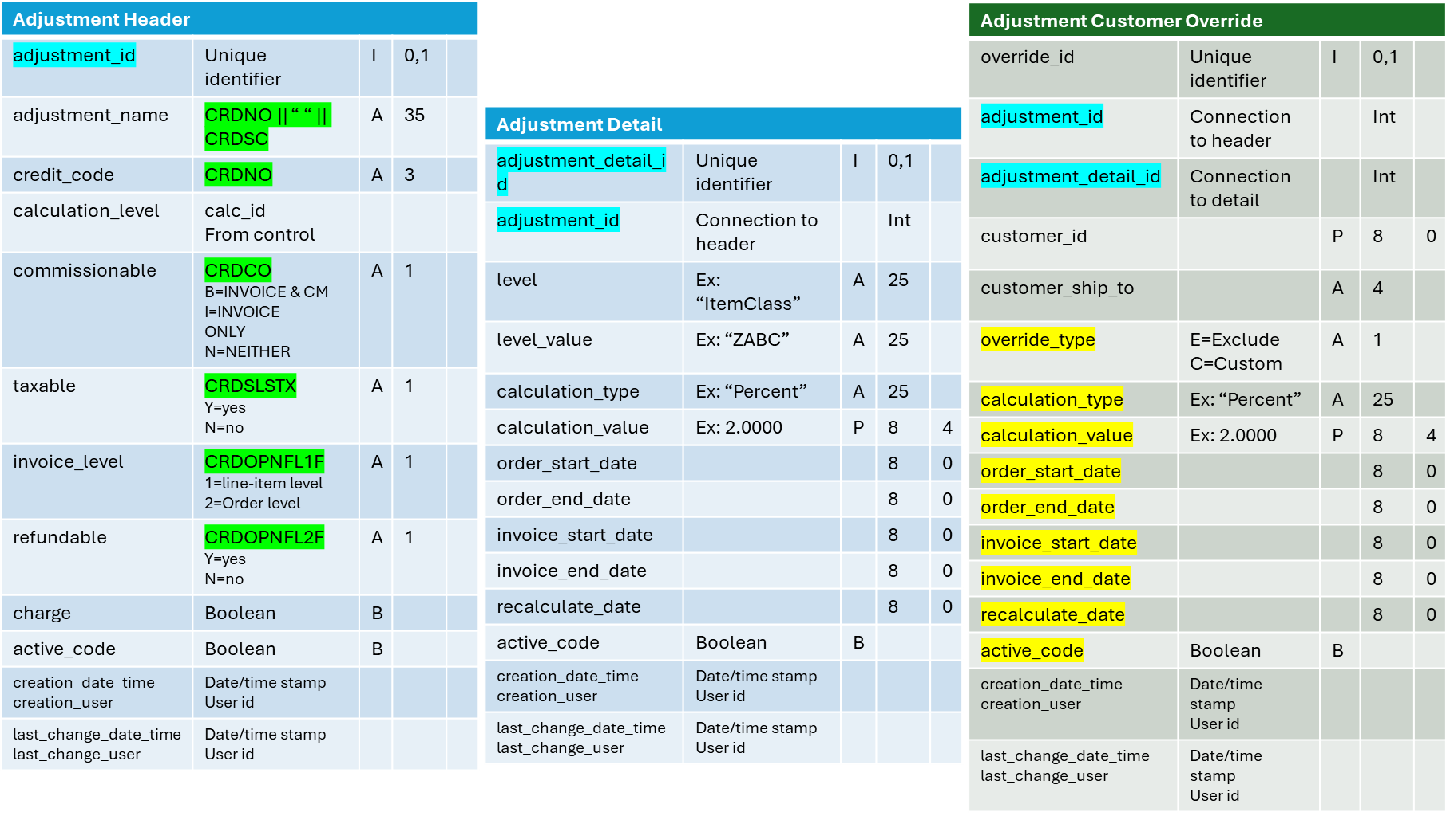
Data Path
LWise@Ashleyfurni... - Ashley Fur...
Microservice Outbound – Order Level
Order ID | Input | A | 7
Customer ID | Input | P | 8 | 0
Ship To | input | A | 4
Total Surcharge | Sum of all surcharges for this order id | P | 13 | 2
Microservice
Microservice Outbound – Adjustment Level
Item ID | Item number | A | 15
Status | 0=API OFF 1=NONE APPLIED 2=APPLIED | A | 1
Microservice Outbound – Adjustment Details
credit_code | CRDNO | A | 3
adjustment_name | CRDNO || “ “ || CRDSC | A | 35
Adjustment amount | calculated | P | 13 | 2
invoice_level | CRDOPNFL1F | A | 1
taxable | CRDSLSTX | A | 1
commissionable | CRDCO | A | 1
Quantity | Input or 1 | P | 10 | 3
calculation_value | Ex: 2.0000 | P | 8 | 4
calculation_type | Ex: “Percent” | A | 25
applied_level | Ex: “ItemClass” | A | 25
applied_level_value | Ex: “ZABC” | A | 25
charge | Boolean | B

Slide 40
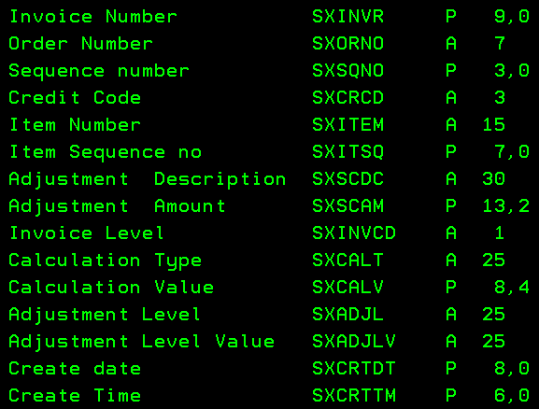
Data Path
LWise@Ashleyfurni... - Ashley Fur...
Microservice Outbound – Order Level
Order ID |  | A | 7
Customer ID |  | P | 8 | 0
Ship To |  | A | 4
Total Surcharge | Sum of all surcharges for this order id | P | 13 | 2
Microservice
TSSCXN
Microservice Outbound – Adjustment Level
Item ID | Item number | A | 15
Status | 0=API OFF 1=NONE APPLIED 2=APPLIED | A | 1
Microservice Outbound – Adjustment Details
credit_code | CRDNO | A | 3
adjustment_name | CRDNO || “ “ || CRDSC | A | 35
Adjustment amount | calculated | P | 13 | 2
invoice_level | CRDOPNFL1F | A | 1
taxable | CRDSLSTX | A | 1
commissionable | CRDCO | A | 1
Quantity | Input or 1 | P | 10 | 3
calculation_value | Ex: 2.0000 | P | 8 | 4
calculation_type | Ex: “Percent” | A | 25
applied_level | Ex: “ItemClass” | A | 25
applied_level_value | Ex: “ZABC” | A | 25
charge | Boolean | B

Slide 41
1446
Credit Code /Special Charge Code
INSCCD
1079
Credit Code
ACRDMAS
COM Rules
Special Charge Code
By item class
Drives u/n
Surcharge Microservice
HJ
Ship the order
Order Mgmt
Release for Invoicing
Calc freight/surcharge
CS254D2
Finance
Auto Invoicing
Nightly Job
Infor XA
Assign u/n based on COM rules
Trip Files
Shipped History
IFM

Slide 42
ARCHIVES

Slide 43
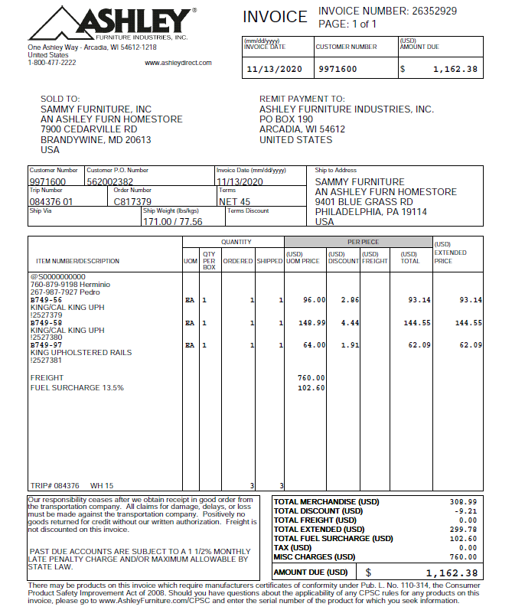
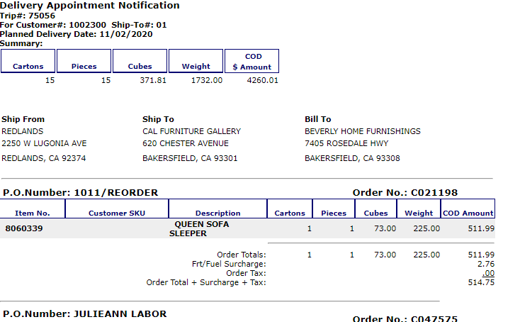
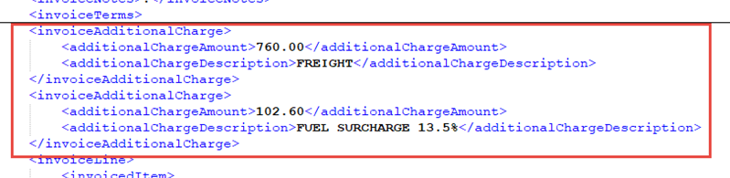
EXAMPLEs
Add Surcharge to
line-item level
With summary line
OLD
IMPORT SURCHARGE $XXX.00
Needs to reflect Surcharge
EDI Roll into price
For MVP

Slide 44
Microservice Logic
Receive Parms
Check Switch
Status?
OFF
Return level 0
*
ON
Cache
Order, Cust, ShipTo, Order Date, Ship Date, Invoice Date, Whs, Item, Price, Adjustment Info
Reference Cache
*Number of hours for cache should be stored in a control table where it can be easily adjusted. (start with 24)
**Cache will be held for order/customer/ship to/order date/ship date/invoice date/warehouse/item/price for x hours. All output parameter detail will be held for quantity of 1.
  Status, adjustment name, adjustment amount, invoice level, taxable, commissionable, quantity=1, calculation value, calculation type, applied level, applied level value, charge.
  If the caller passes a quantity other than one, simply multiply the adjustment amount by that quantity for the return adjustment amount.
NO
Call Product API to retrieve all Item Information
Cached?
Process Calculator for each order/item
OLD
YES
**
Use Cached info
Determine if any Item Class Adjustments
<LOGIC>
Cache Adjustments based on quantity of 1
Future Adjustment
Future Adjustment
Done
YES
Return Adjustments

